Slide 1
[Final Project] Employment
File created on: 10/15/2024 10:31:43 PM

Slide 2
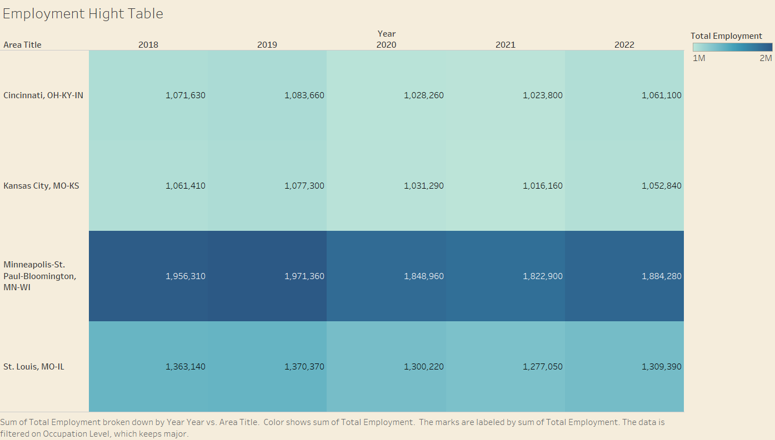

Slide 3
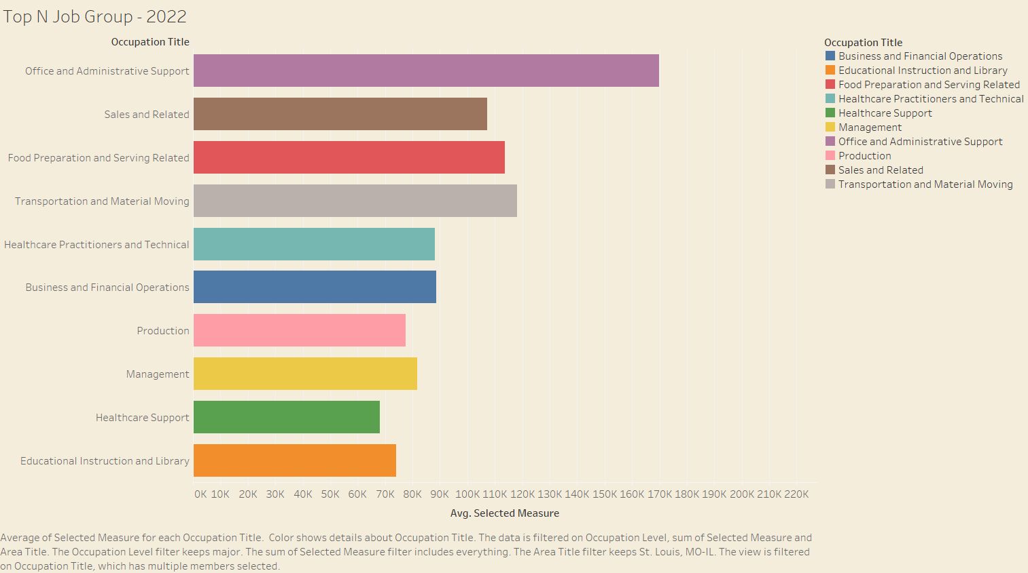

Slide 4
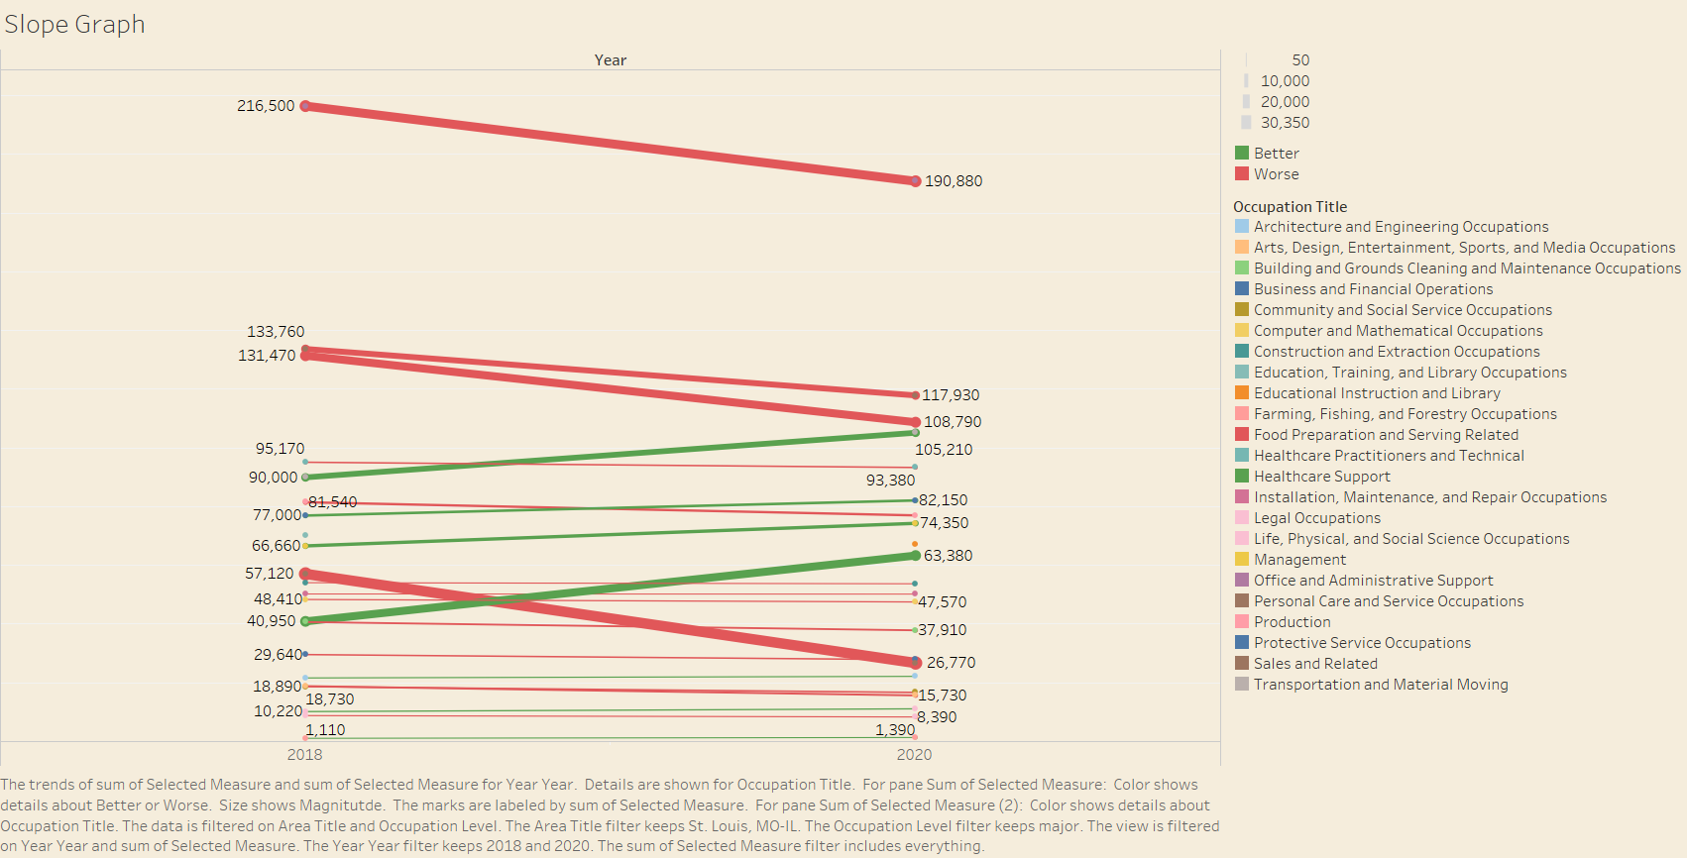

Slide 5
